Slide 1

CRIME ANALYSIS OF CHARLOTTE, NC
FINAL PROJECT: UNCC DATA ANALYTICS BOOTCAMP
Kimberly Cavazos, Brenton Ervin, Ryan Marshall, Fiston Rugwiro
Notes:
Each person gives a brief introduction to themselves and their background.

Slide 2

TOPIC DISCUSSION
Analyze the crime data in Charlotte, NC and the surrounding area within Mecklenburg County.
Why did we choose this?

Slide 3
QUESTIONS TO ANSWER
Although various crimes and their underlying nature seem to be unpredictable, how unforeseeable are they really?
Is Charlotte a safe place to live?
Where is the safest place in the Charlotte are per the crime data?
Can we use machine learning to develop an efficient method to take preventative measures?
Can we predict crimes before they even occur?
Can we predict the frequency of violent crimes occurring per month in Charlotte?

Slide 4
HOW ARE WE GOING TO ANSWER THESE QUESTIONS?
OBTAIN
OBTAIN DATA FROM REPUTABLE SOURCES
CMPD (Charlotte Mecklenburg Police Department)
NIBRS (FBI's National Incident-Based Reporting System)
ETL
ETL PROCESS
VISUALIZE
VISUALIZE DATA WITH AN INTERACTIVE DASHBOARD
CREATE
CREATE A MACHINE LEARNING MODEL
Use violent crime data and try to predict the frequency of crimes occurring during a specified time period.

Slide 5
EXTRACT
Gather and Download Credible Data (CMPD)
Inspect all data
TRANSFORM
Convert Data Types
Drop Null Values
Transform Data Types
Join Tables
Export as Clean CSVs
LOAD
Use clean data for visualizations and Machine Learning model
Create Database in Postgress

Slide 6
ETL PROCESS/ DATA SOURCES
Gathered Data
Inspected all Data in Python
Convert Data Types
Export as Clean CSV’s
Import Data from cleaned CSV’s
Export Table as CSV
Create Machine Learning Model
Create Database in Postgress
Create Visualizations
Notes:
Fiston & Brenton: Discuss the process. Make sure to discuss that we created the database but did not actually use it for the Machine Learning piece.

Slide 7
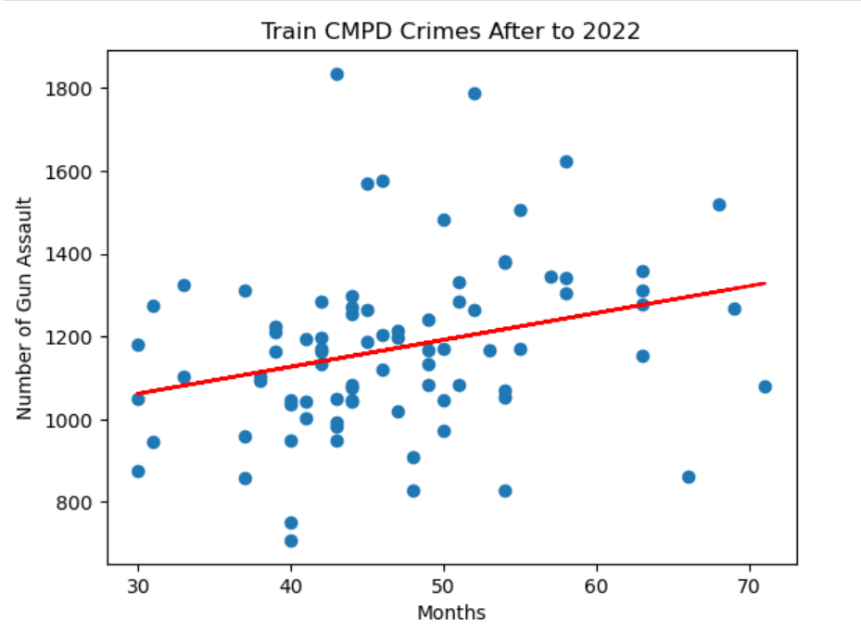
MACHINE LEARNING MODEL
Linear Regression Model
What we wanted to do… Predict frequency of crime per month.
We are now using a linear regression model to predict the frequency of violent crimes with a gun occurring per month.
LESSONS LEARNED:
Linear Regression model does not work for this data.
Scary note: gun violence was the only point that made sense!
Total of Incidents per Month
Data Timeline
Notes:
Ryan: Discuss the machine learning model and process. Problems encountered. Why we picked this.

Slide 8

VISUALIZATIONS
INTERACTIVE TABLEAU DASHBOARD
Notes:
Kim

Slide 9

SUMMARY
According to the Heat map, the northern part (Huntersville) of the county would be the safest place for the client and family.
University City area seems to have the most crime.
Based on our analysis, we feel that the Charlotte area could be a safe enough place for our client.
There were approximately 880 thousand people living in Charlotte in 2021
The number of incidents compared to the population size does not appear to be significant
Use caution anywhere
We hoped to use our Machine Learning Model to show the frequency of crimes occurring per month to predict the likelihood of a crime occurring in a specific time period.
Our model did not work for this and therefore we can not confidently provide that information.

Slide 10
DISCUSSION
Roadblocks
What could we have done differently if we had more time and more training?
QUESTIONS???

